Slide 1

Uber Fare Price Prediction
RNS INSTITUTE OF TECHNOLOGY
BENGALURU - 98
DEPARTMENT OF INFORMATION SCIENCE & ENGINEERING
Presentation on Internship
Jaswanth Ramichetty Reshma G
USN: 1RN19IS117 USN: 1RN19IS119
Inflow Technologies
Guide
Mr. T S Bhagavath Singh
Associate. Prof, Dept of ISE, RNSIT
Panel Member
Dr. Hema N
Assistant. Prof, Dept of ISE, RNSIT

Slide 2
AGENDA
Abstract
About the Company
Introduction
Literature Survey
Requirements
System Design
Detailed Design
Implementation
Results
Conclusion and Future Enhancements
References
Q & A

Slide 3
ABSTRACT
This project is about the world's largest taxi company Uber. In this project, we will predict the fare amount for future transactional process and compare the actual value and predicted value and measure their accuracy.
Uber delivers service to lakhs of customers daily. Now it becomes really important to manage their data properly to come up with new business ideas to get best results. Eventually, it becomes really important to estimate the fare prices accurately.
This Dataset contains following fields: 1)Key:- A unique id(Identifier) for each passenger 2)fare_amount:- The cost of the trip 3)pickup_datetime:- the time of pickup the passenger 4)passenger_count - The number of passengers in the vehicle (driver entered value) 5)pickup_longitude - the longitude where the meter was engaged 6)pickup_latitude - the latitude where the meter was engaged 7)dropoff_longitude – the longitude where the meter was disengaged 8)dropoff_latitude - the latitude where the meter was disengaged.

Slide 4
About the Company
Inflow Technologies addresses the growing needs of organizations to manage and secure information more effectively and intelligently.
The team at Inflow Technologies are well-versed with latest and the most powerful technologies available today for locating, organizing, managing, retrieving, analyzing, protecting, and presenting information.
The business focus is mainly on Networking ,Cybersecurity ,Unified Communication and Collaborations ,Storage and Server Management ,Infrastructure and Application Software ,AIDC ,Electronic Security and Services.

Slide 5
INTRODUCTION
We don’t even remember some people refuses a ride in the dead of the night or on late evenings. All this – and much more, with the advent of online cab services, through which a user can book a ride in a matter of a few minutes.Thus Uber came into existence in order to help people.
But people were scared about the fare amount it might charge for the destination they have choosen. Hence,Uber with the help machine learning algorithms calculated the fare amount and displayed to the customers while booking only.
The proposed work can be used to predict the fare amount using the machine learning algorithm which is used for future transactional purpose and compare the actual price with the predicted price.
We will split our dataset into two for training and testing. We will test the model for accuracy.

Slide 6
LITERATURE SURVEY
Title and author | Technology used | accuracy
Modelling and analysis of ubers rider pricing J unzhi Chao (2019) | Statistical regression and prediction technique | 78%
Predicting uber demand in cities:approaching the limit of predictability Denis Khryashchev (2020) | Time series prediction | 76%
End-to-end predictive analysis on uber Sharvari Santhosh (2021) | Analytics and scientific data | 79%

Slide 7
Requirements
Numpy 1.19.5
pandas 1.1.5
scikit-learn 0.24.1
sklearn 0.0
Vscode
Streamlit
Google Colab

Slide 8
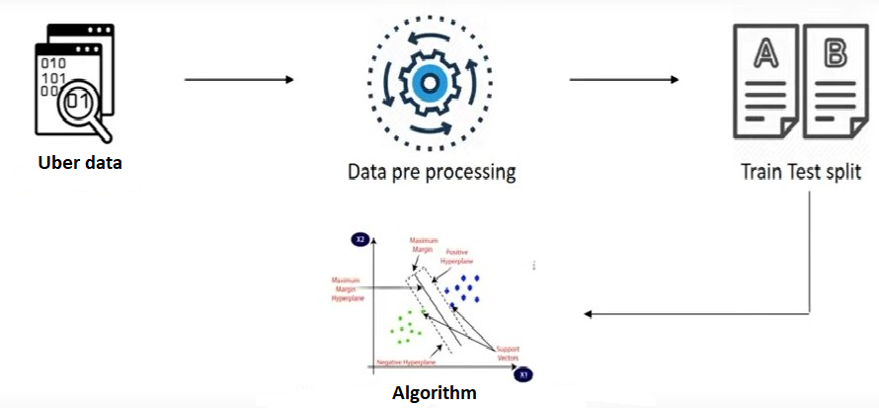
System Design

Slide 9
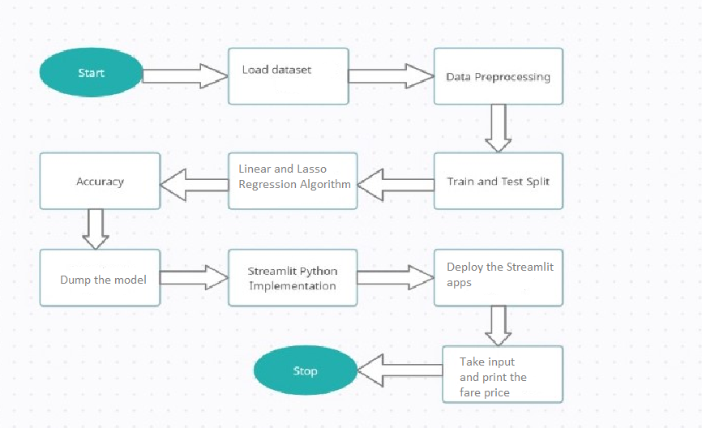
Detailed Design
Design details

Slide 10
Implementation / Coding
Linear Regression Algorithm
from sklearn.linear_model import LinearRegression
x_train,x_test,y_train,y_test=train_test_split(x,y,test_size=0.25,random_state=10)
LR=LinearRegression()
LR.fit(x_train,y_train)
linear_pred=LR.predict(x_test)
linear_pred
Lasso Regression Algorithm
from sklearn.linear_model import Lasso
x_train,x_test,y_train,y_test=train_test_split(x,y,test_size=0.25,random_state=10)
lasso=Lasso()
Lasso.fit(x_train,y_train)
lasso_pred=LR.predict(x_test)
lasso_pred

Slide 11
Design
Model Deployment
def user_report():
pickup_longitude=st.sidebar.slider("Pickup longitude",-180.0,180.0)
pickup_latitude=st.sidebar.slider("PickupLatitude",90.0,90.0)
dropoff_longitude=st.sidebar.slider("Dropoff
Longitude",180.0,180.0)dropoff_latitude=st.sidebar.slider(" Dropoff Latitude",-90.0,90.0)
passenger_count=st.sidebar.slider(" Passenger Count",1,8)
Distance=st.sidebar.slider("Distance",0.010000,53.070000)
Year=st.sidebar.slider("Year",2009,2015)
Month=st.sidebar.slider("Month",1,12)
Day=st.sidebar.slider("Day",1,31)
DayofWeek_num=st.sidebar.slider("Day of Week num",0,6)
Hour=st.sidebar.slider("Hour",0,23)
counter=st.sidebar.slider("Counter",0,1)
user_report_data={
'pickup_longitude':pickup_longitude,
'pickup_latitude': pickup_latitude,
'dropoff_longitude': dropoff_longitude,
'
'dropoff_latitude': dropoff_latitude,
'passenger_count':passenger_count,
'Distance':Distance,
Year': Year,
'Month': Month,
'Day': Day,
'Day of Week_num':DayofWeek_num,
'Hour':Hour,
'counter': counter
}
report_data=pd.DataFrame(user_report_data,index=[0])
return report_data
user_data=user_report()
st.header('Uber data')
st.write(user_data)
Fare=model.predict(user_data)
st.subheader('Uber fare')
st.subheader(np.round(Fare[0],2)

Slide 12
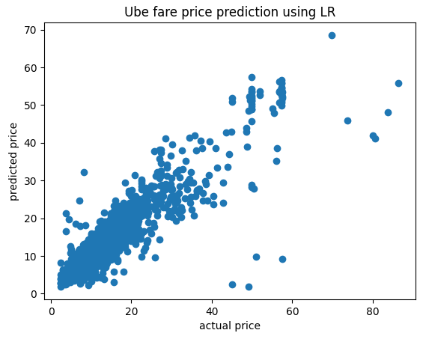
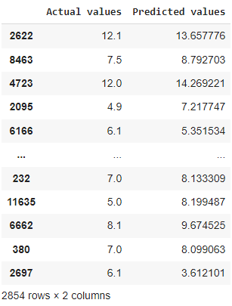
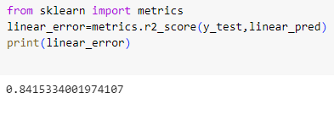
RESULTS
Linear Regression

Slide 13
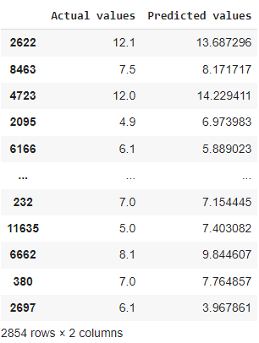
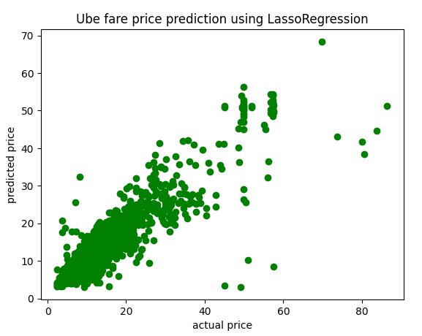
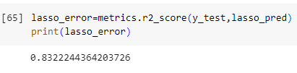
Results
Lasso regression

Slide 14
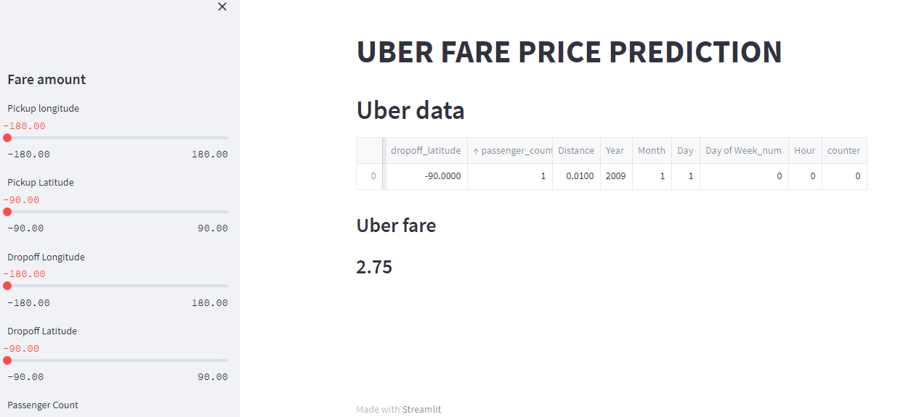
Results
Model deployment is the process of putting machine learning models into production. The homepage contains eight input fields upon which being entered will predict the fare amount to be paid in dollors. This model is deployed using Streamlit web Application Programming Interface.

Slide 15
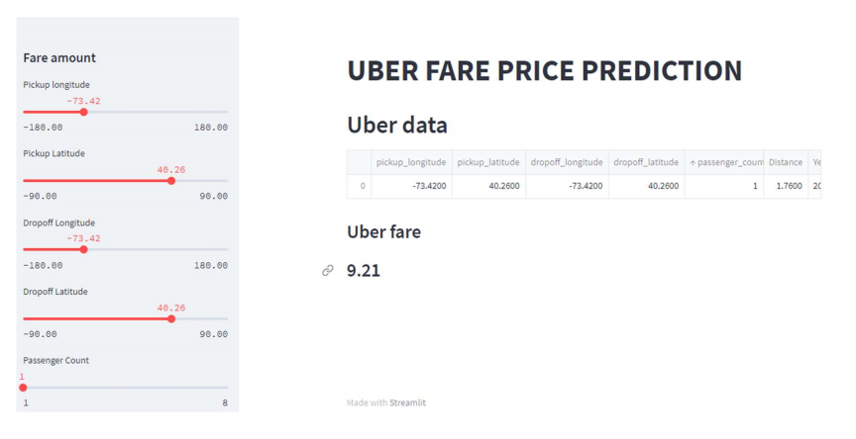
RESULTS

Slide 16
CONCLUSIONS
Our main focus is to find out the most suitable algorithm that can predict the fare price effectively.
The main purpose of this project is to highlight all the previous studies of machine learning algorithms that are being used for uber fare price prediction, this project provides the all necessary information to analyze the machine learning algorithms.
Visualising the distribution of data & their relationships, helped us to get some insights on
the feature-set.
It is been observed Linear Regression yields the highest classification accuracies when compared with lasso Regression.
The proposed system greatly helps in predicting the fare amount by using paramaters such as pickup longitude,pickup latitude,drop-off latitude,drop-off longitude.

Slide 17
Future Enhancements
We can make the interface more appealing to everyone.
We can introduce more accurate algorithms in the future to enhance the price
prediction.
We can use various types of regressions in the code.
We can further make the interface more user friendly.
We can also introduce chat bots to help people easily.

Slide 18
REFERENCES
[1] A retrospective on Taxi Hailing methodology Sanskar Shah Student, Department of Information Technology, K J Somaiya College of Engineering, Maharashtra, India. International Research Journal of Engineering and Technology (IRJET) e-ISSN: 2395-0056 Volume: 07 Issue: 09 | Sep 2020 www.irjet.net p-ISSN: 2395-0072
[2] Banerjee, Pallab & Kumar, Biresh & Singh, Amarnath & Ranjan, Priyeta & Soni, Kunal. (2020). Predictive Analysis of Taxi Fare using Machine Learning. International Journal of Scientific Research in Computer Science, Engineering and Information Technology. 373-378. 10.32628/CSEIT2062108.
[3] Chao, Junzhi. (2019). Modeling and Analysis of Uber’s Rider Pricing. 10.2991/aebmr.k.191217.127.
[4] Faghih, Sabiheh & Safikhani, Abolfazl & Moghimi, Bahman & Kamga, Camille. (2017). Predicting Short-Term Uber Demand Using Spatio-Temporal Modeling: A New York City Case Study.
[5] Khandelwal, K., Sawarkar, A. ., & Hira, S. (2021). A Novel Approach for Fare Prediction Using Machine Learning Techniques. International Journal of Next-Generation Computing, 12(5). https://doi.org/10.47164/ijngc.v12i5.451
[6] Kunal, Arora & Kaur, Sharanjit & Sharma, Vinod. (2021). Prediction of Dynamic Price of Ride-On-Demand Services Using Linear Regression. International Journal of Computer Applications & Information Technology. 13. 376-389.
[7] Predicting real-time surge pricing of ride-sourcing companies Matthew Battifaranoa , Zhen (Sean) Qiana,b, A Department of Civil and Environmental Engineering, Carnegie Mellon University, Pittsburgh, PA 15213, United States b Heinz College, Carnegie Mellon University, Pittsburgh, PA 15213, United States
[8] Zhao, Kai & Khryashchev, Denis & Huy, Vo. (2019). Predicting Taxi and Uber Demand in Cities: Approaching the Limit of Predictability. IEEE Transactions on Knowledge and Data Engineering. PP. 1-1. 10.1109/TKDE.2019.2955686
[9] Kaggle

Slide 19
Question and Answer

Slide 20
THANK YOU

